Slide 1



RATIONAL
EXPONENTS
Lesson 3

Slide 2

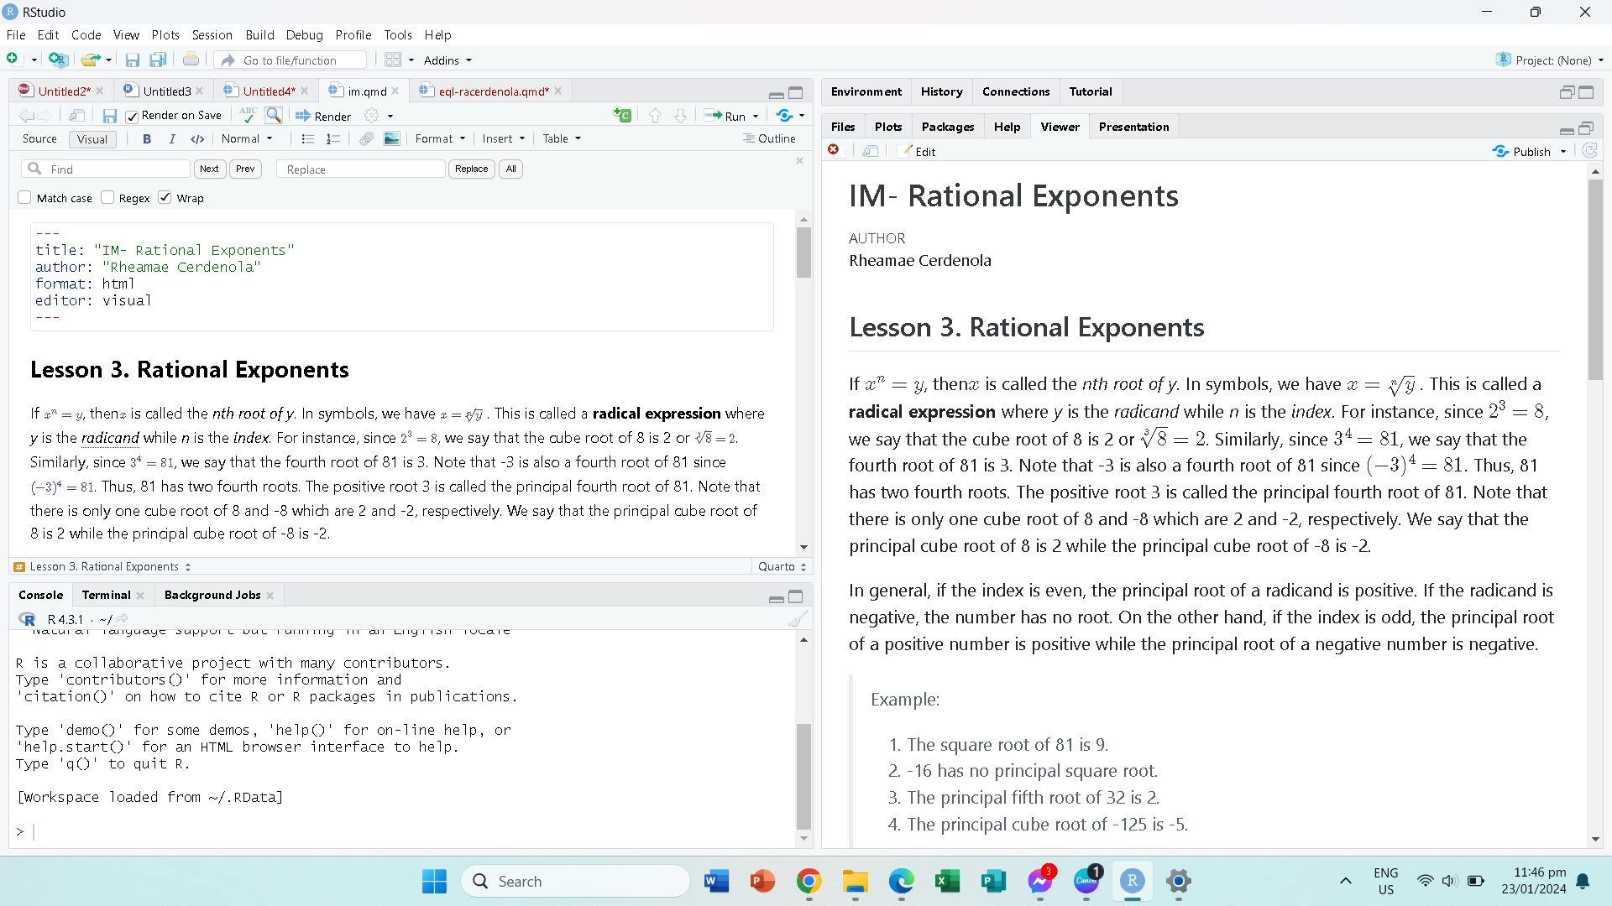

definition

Slide 3


example:
The square root of 81 is 9.
-16 has no principal square root.
The principal fifth root of 32 is 2.
The principal cube root of -125 is -5.

Slide 4
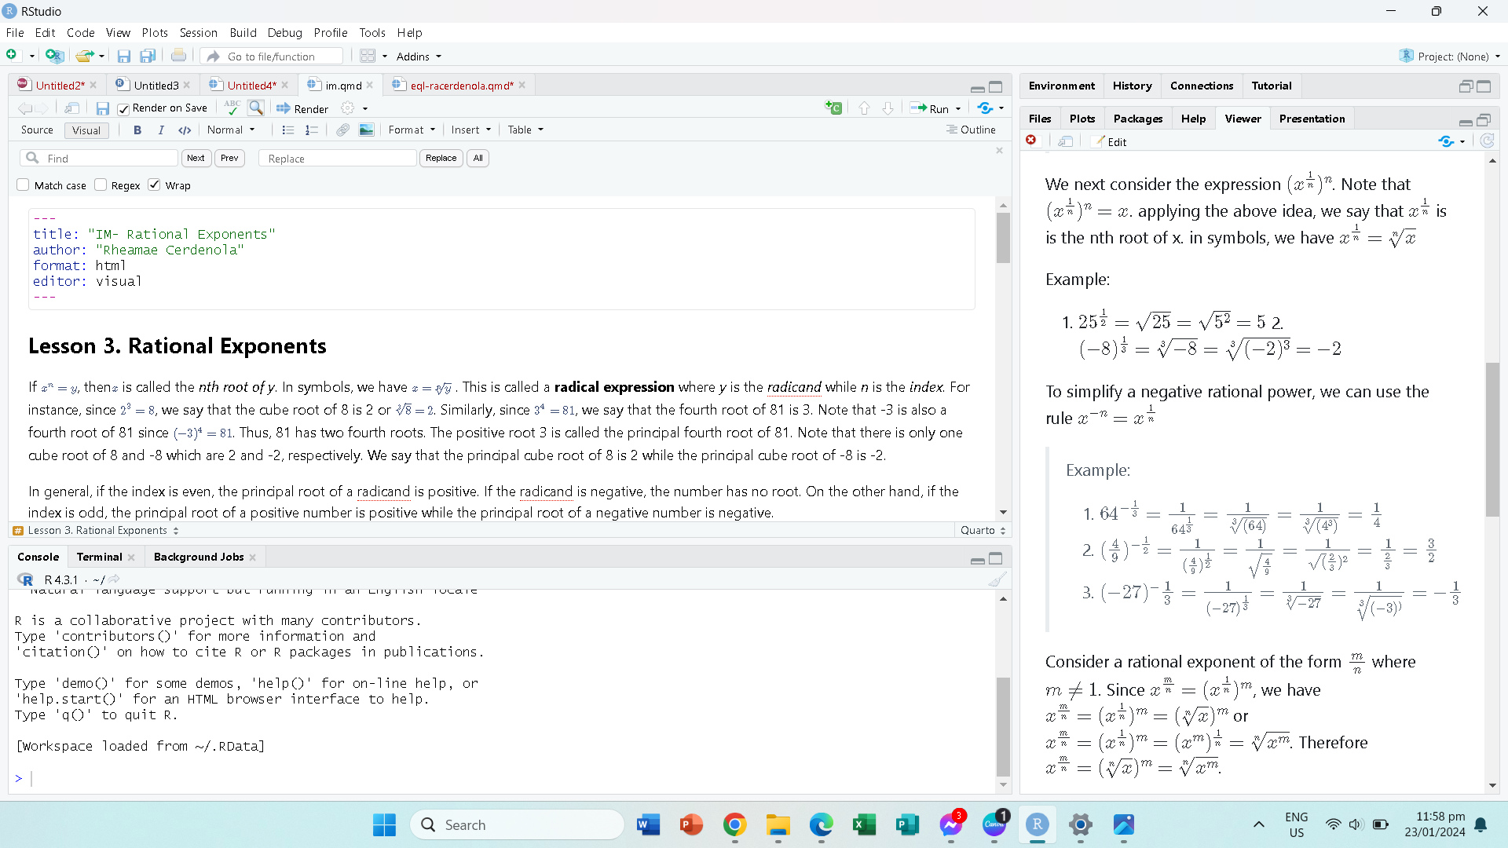

Slide 5
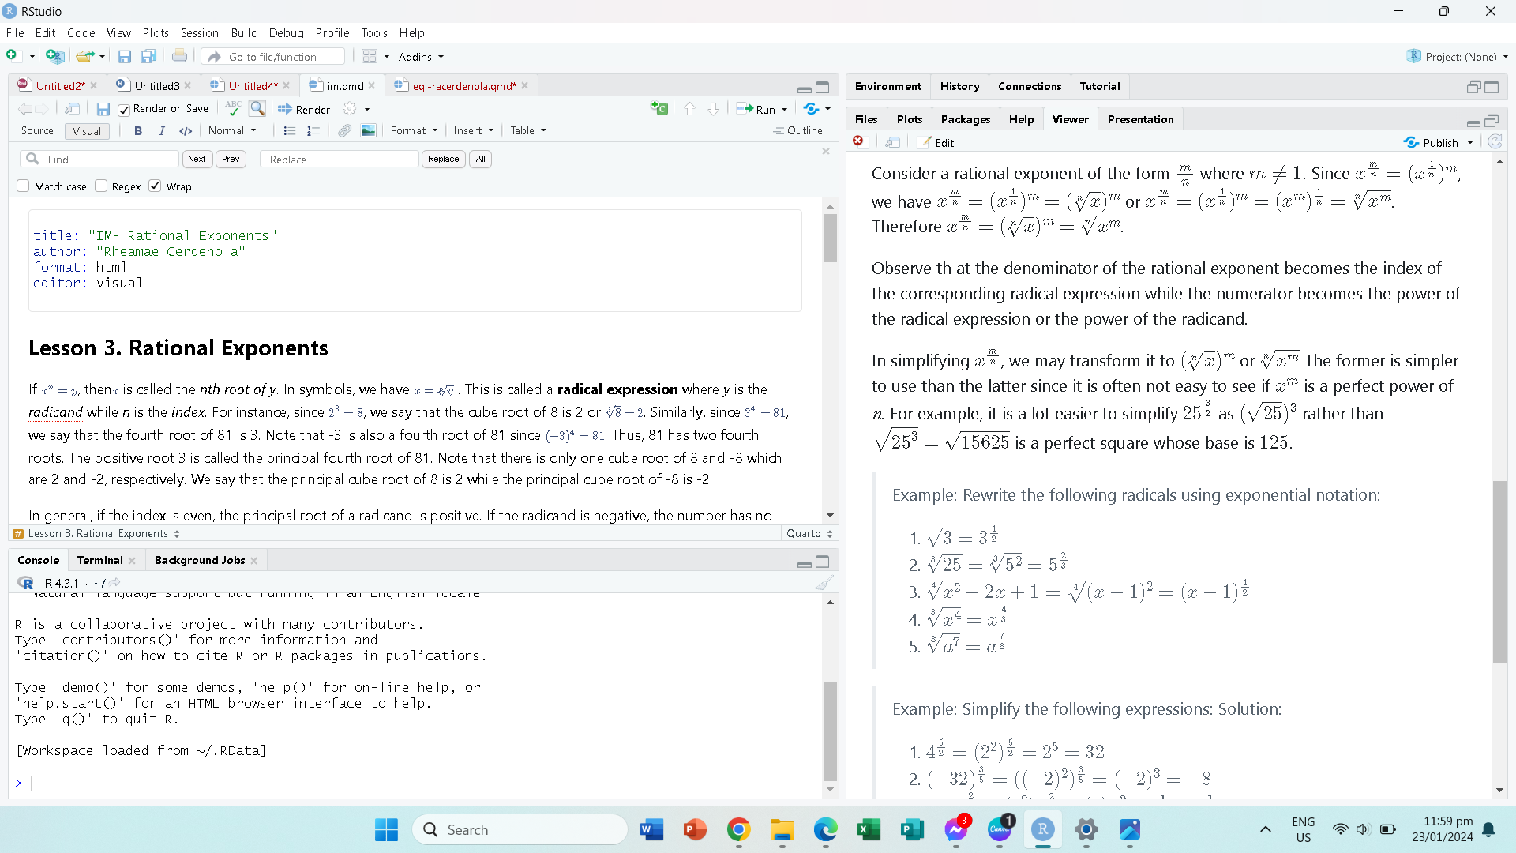

Slide 7
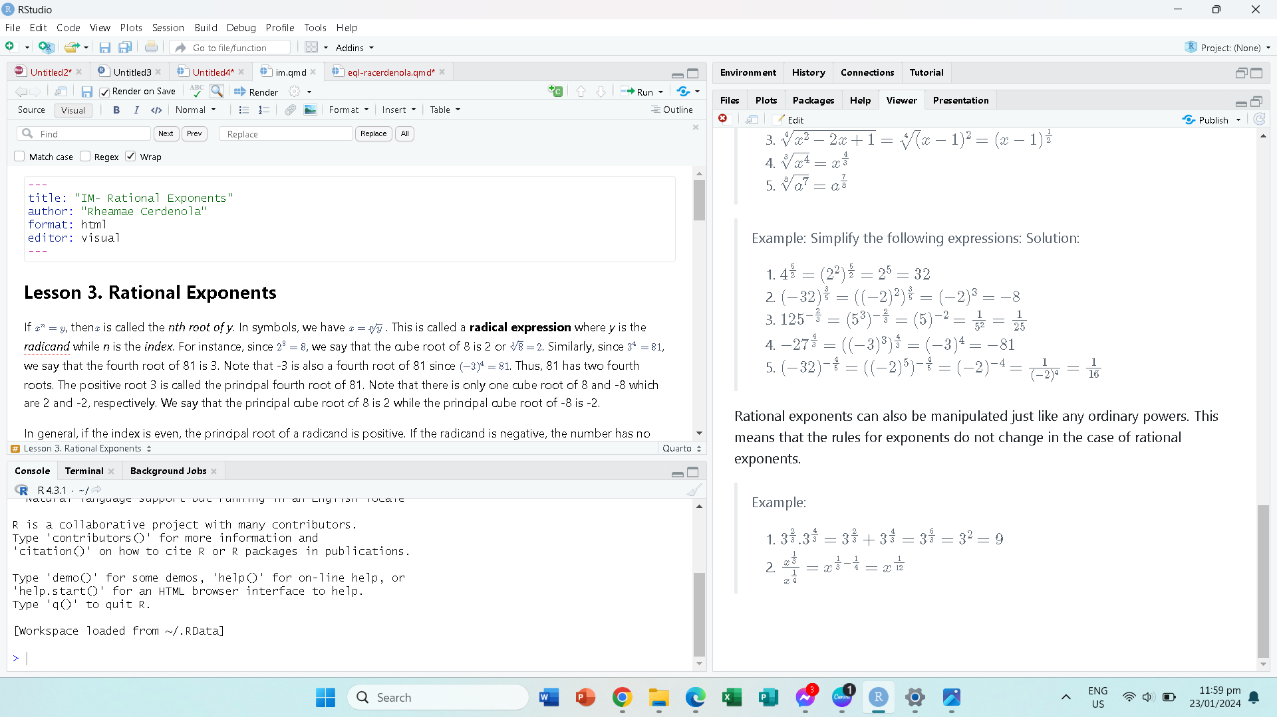

Slide 9


Thank you

